Slide 1

HOSPITAL MANAGEMENT SYSTEM
PRESENTED BY ASHISH KUMAR

Slide 2
Introduction
Hospital Management System provides the benefits of enhanced administration & control, superior patient care, strict cost control and improved profitability. Hospital Management System is powerful, flexible and easy to use and is designed and developed to deliver real coneivable benefits to hospitals.

Slide 3
Objectives
Design a system for a better patient care.
Reduce Hospital operating cost.
Better coordination among the different departments.
To digitalize, the process of Registering New Patient and Doctor, Booking an Appointment, and viewing list of all appointments.
To digitalize all the version of manual systems.
To provide a paper-less hospital.

Slide 4







Technologies Used

Slide 5
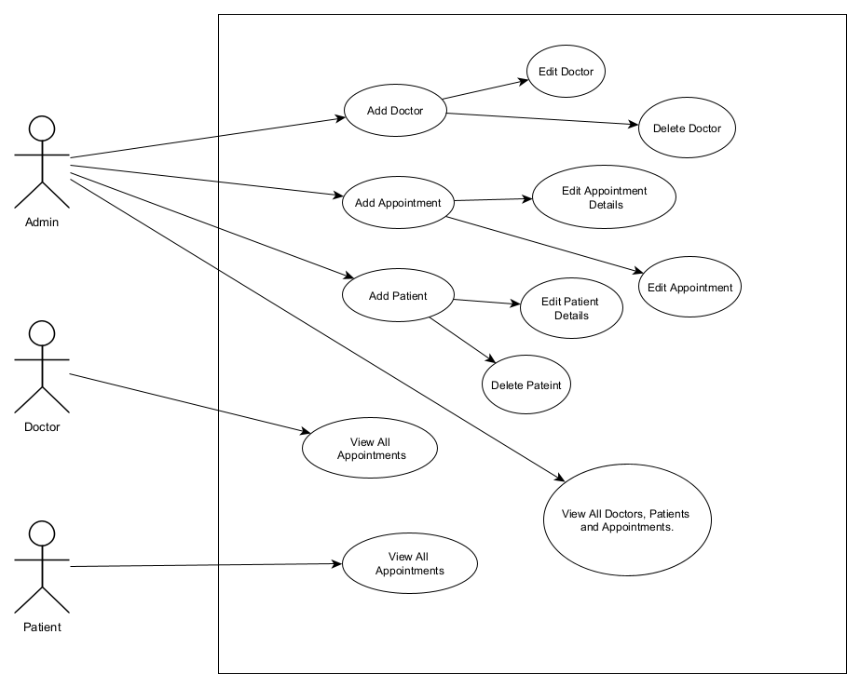
Use Case Diagram

Slide 6
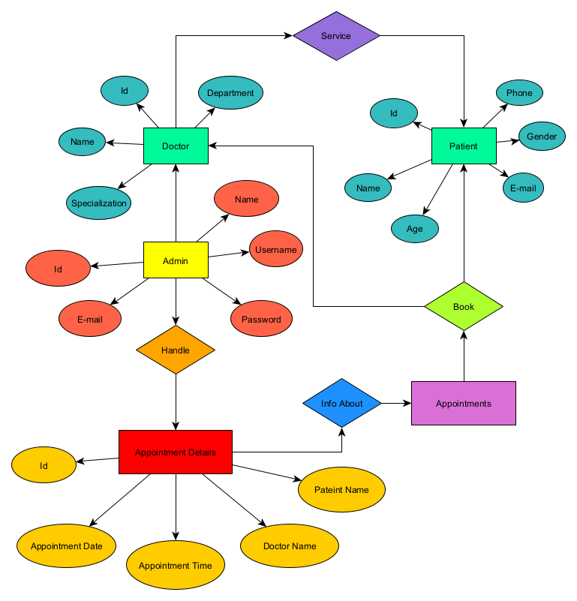
Architecture Design

Slide 7
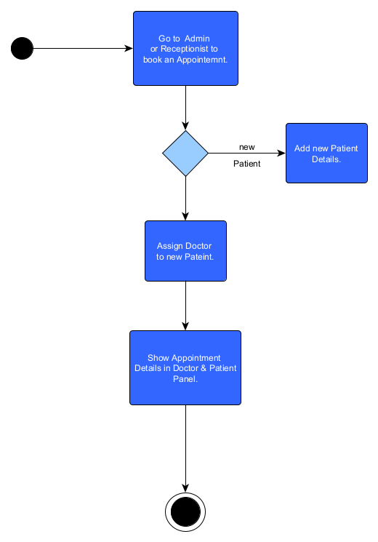
Sequence Diagram

Slide 8
Modules in HMS
ADMIN MODULE
DOCTOR MODULE
PATIENT MODULE

Slide 9
Modules Explanation
Admin Module
Add Doctors, Patients and Appointments.
Delete Doctor, Patient and Appointment information.
Update the informations of Doctor and Patient.
View list of all Doctors, Patients and Appointments.

Slide 10
Modules Explanation
2. Doctor Module
View all Appointments.
3. Patient Module
View all Appointments.

Slide 11
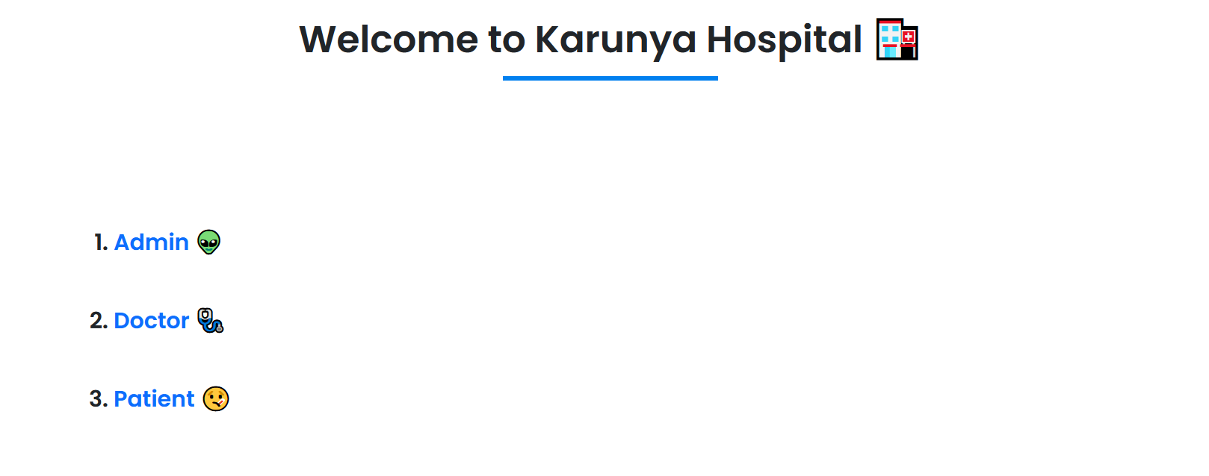
Output Screenshots

Slide 12
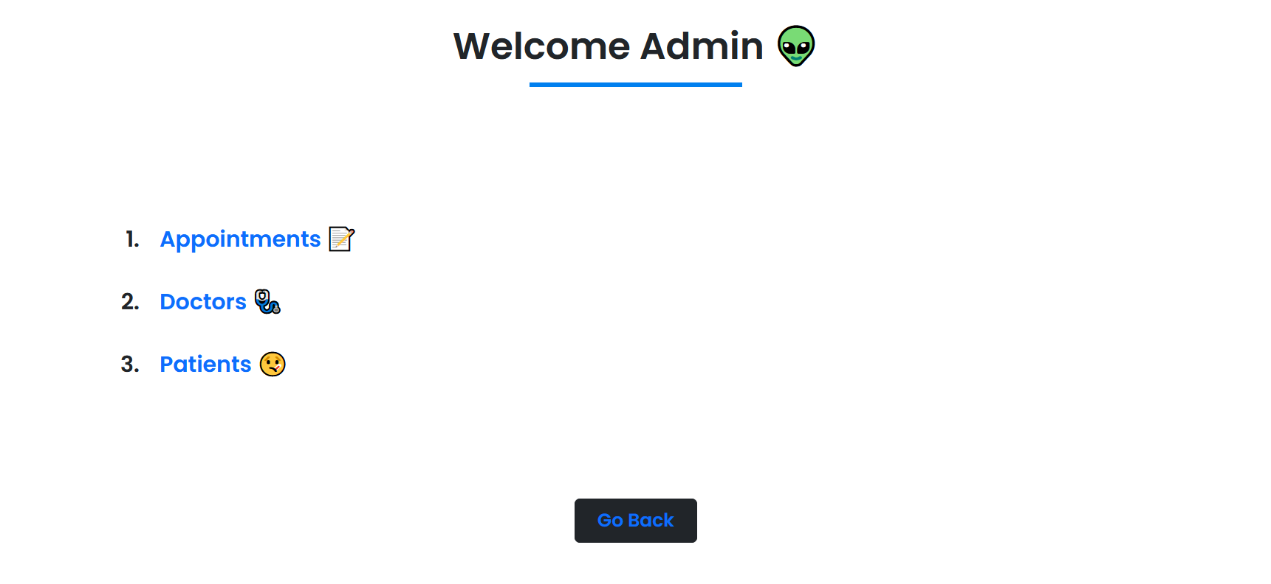
Output Screenshots

Slide 13
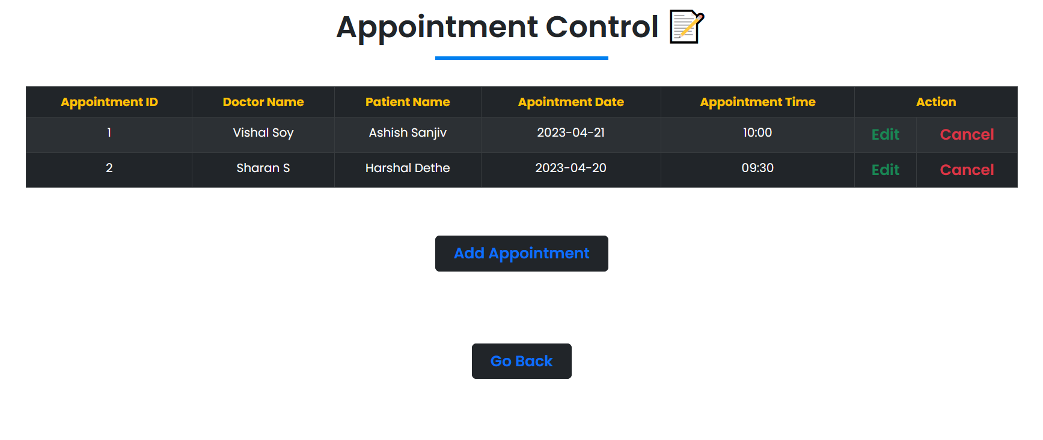
Output Screenshots

Slide 14
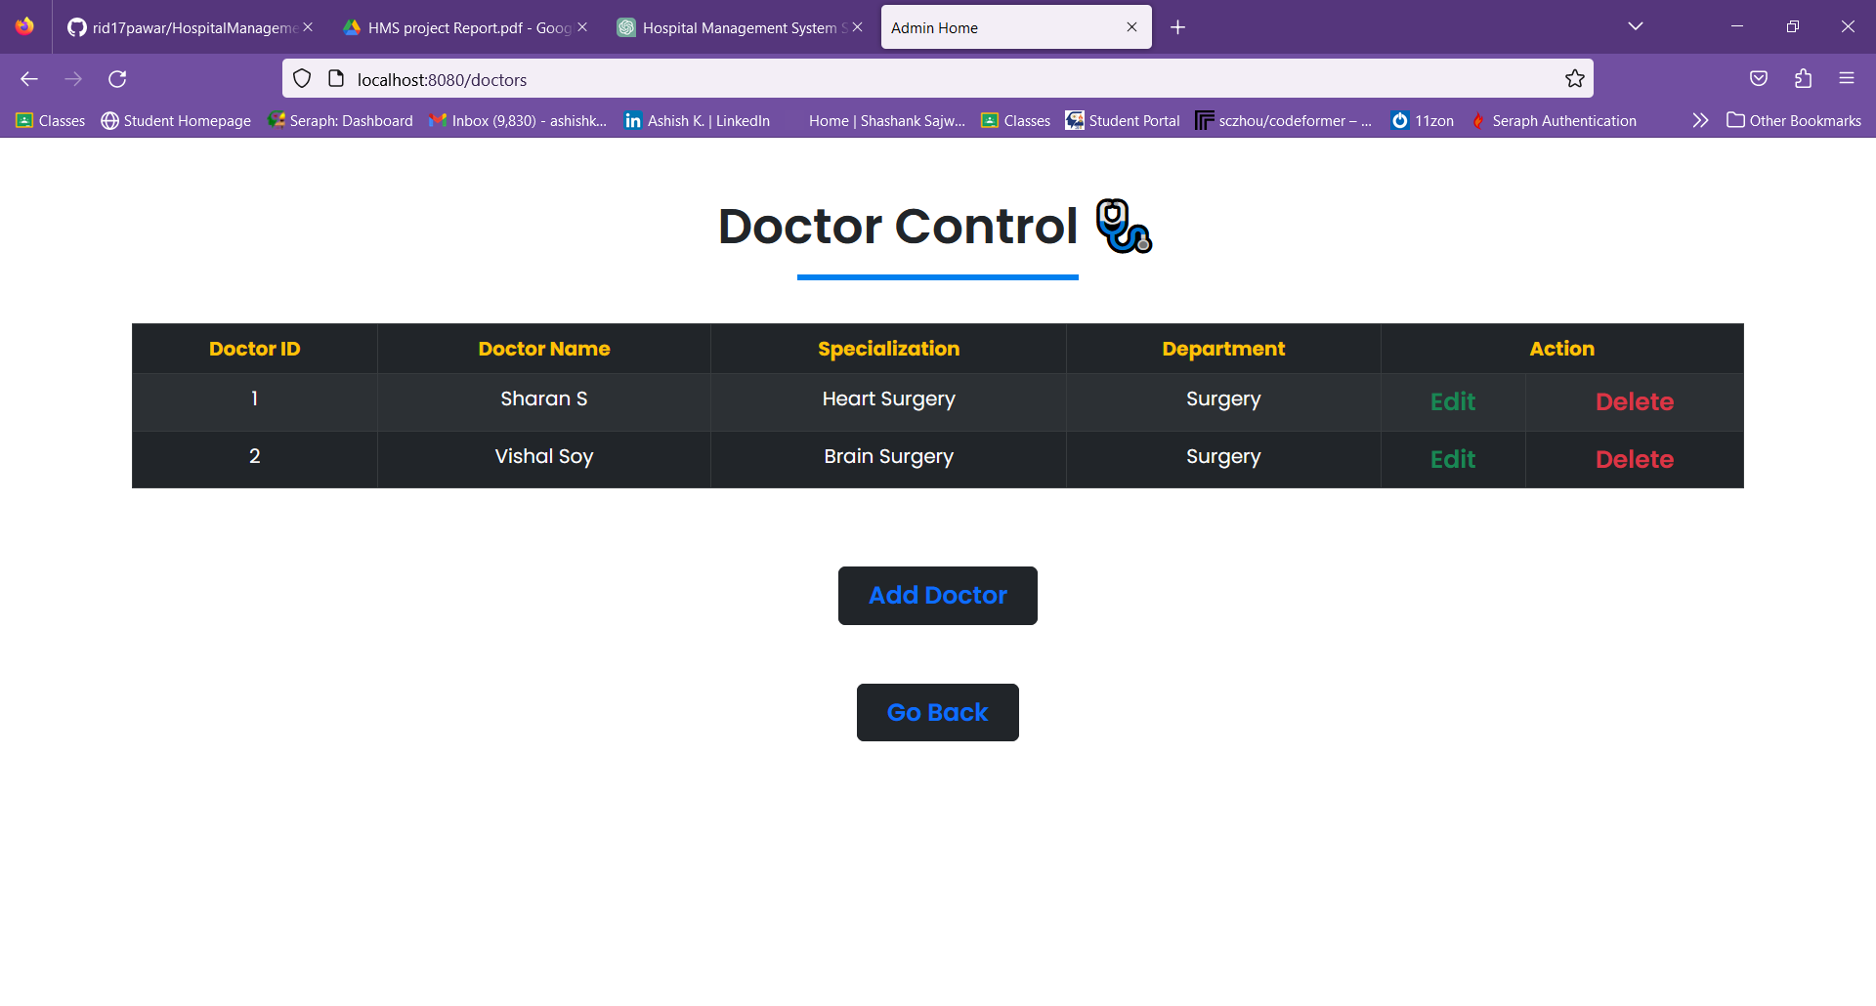
Output Screenshots

Slide 15
Output Screenshots

Slide 16
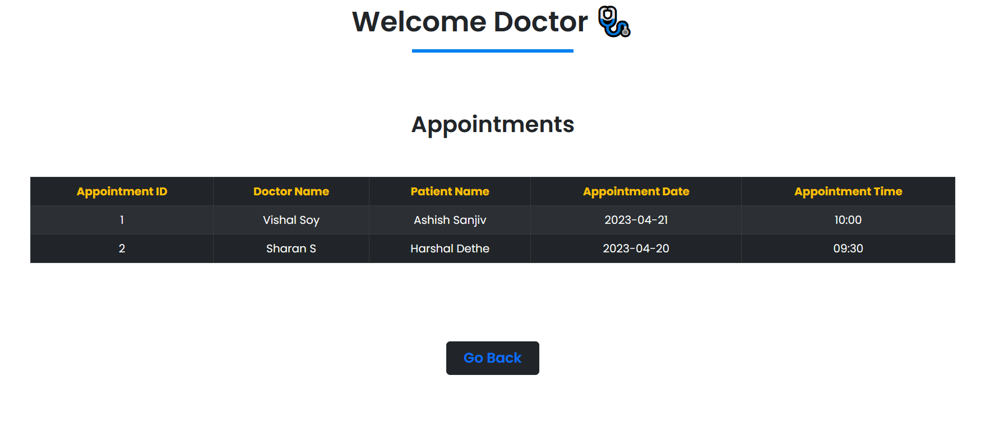
Output Screenshots

Slide 17

Output Screenshots

Slide 18
Benefits of the Application
Reduce time wasted in retrieving data especially in finding a past health records.
Increase efficiency and interactivity in any area of specialization in the hospital.
Able to quickly view, edit and delete, summazrize and adjust data.
For small and middle scale hospitals.

Slide 19
Conclusion
The project helps in making paperless activities. It reduces the workload from Doctor and Admin. It provides more ease and flexibility to Doctor, Admin and Patient. The digitalization has reduced costs of Hospital. This work has created a little awareness and promotes the idea that the concept of paperless office is reality.

